Slide 1
Module 5: Developing a Multisensory Environment
Module 5D: Recommendations for Learning Environments
www.multisensorylearning.lgfl.net ©2018 www.hirstwood.com & London Grid for Learning

Slide 2
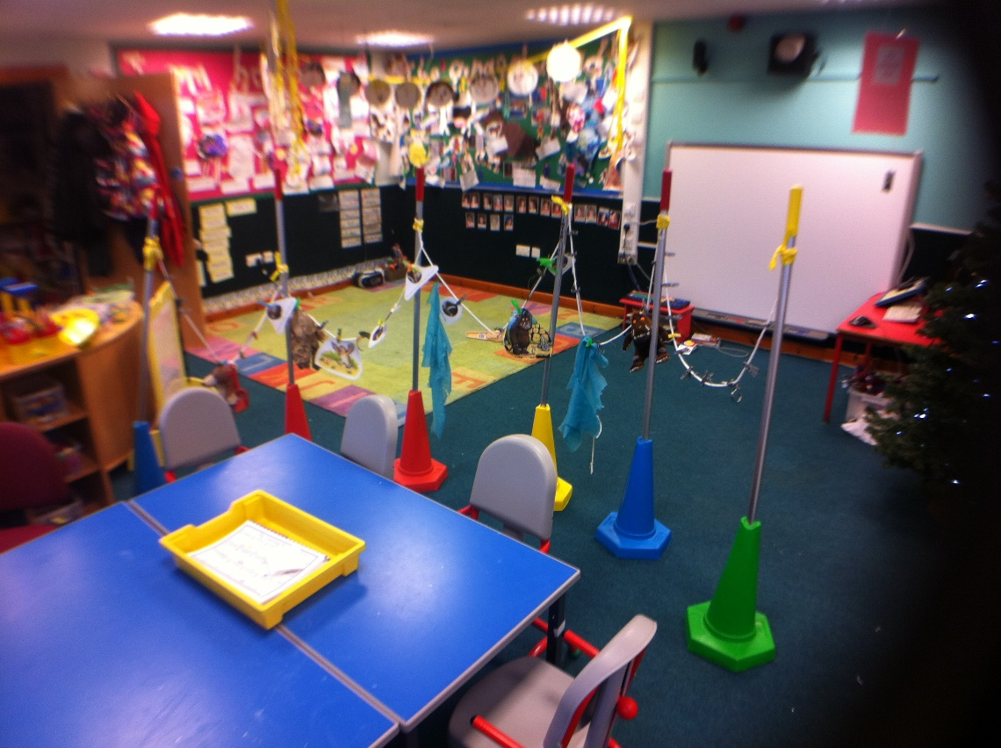
Considerations for Multisensory Environments
Following the completion of your environmental audit, you may want to consider the below questions in order to maximize multisensory learning opportunities and to accommodate the needs of your learners with sensory issues.
www.multisensorylearning.lgfl.net ©2018 www.hirstwood.com & London Grid for Learning

Slide 3
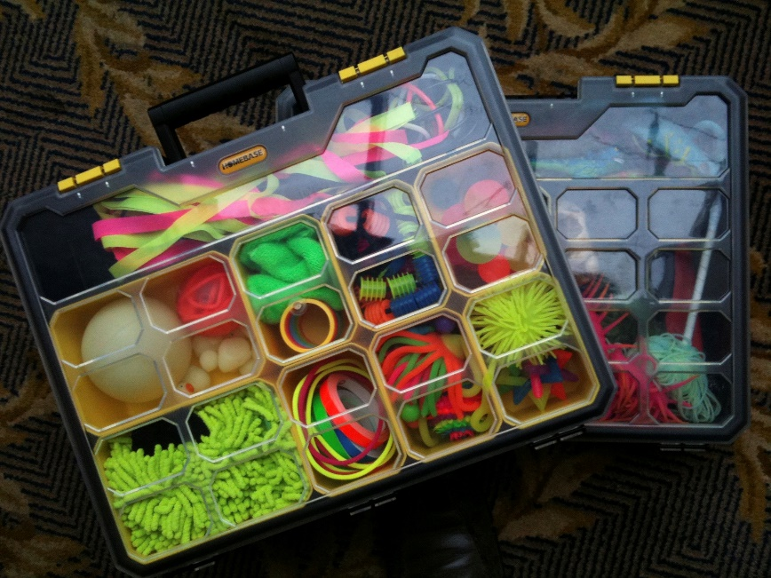
Considerations for Multisensory Environments
Is there good, easily accessible storage? You may need to quickly adapt a learner’s environment or activity - will the tool you need be easy to reach?

Slide 4
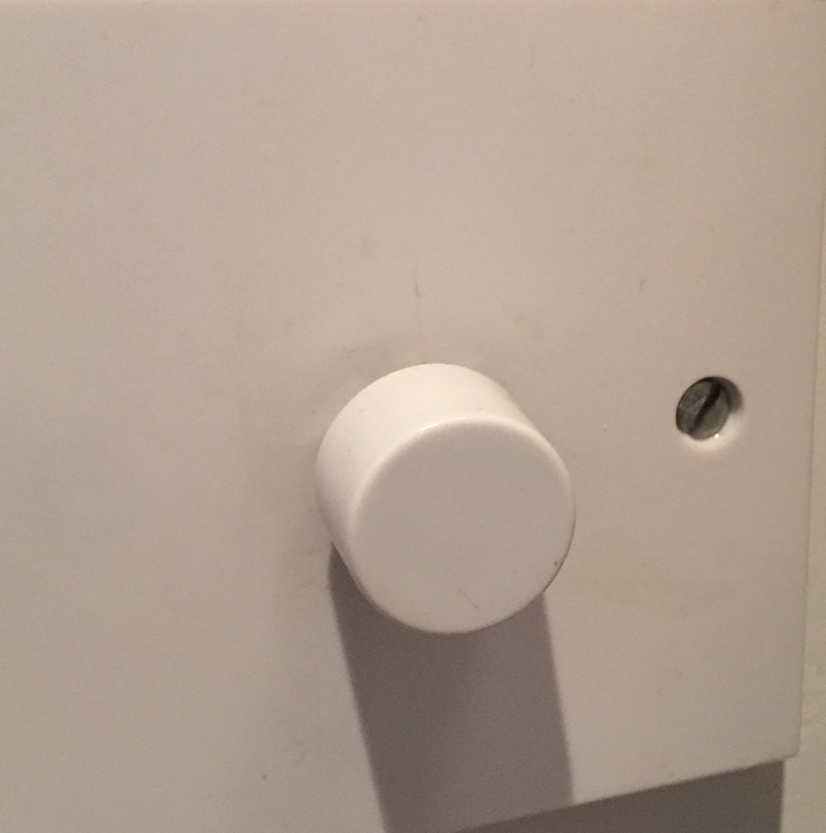
Considerations for Multisensory Environments
Can the lighting levels be easily controlled? Do you have dimmers or zoned lighting for different tasks?

Slide 5
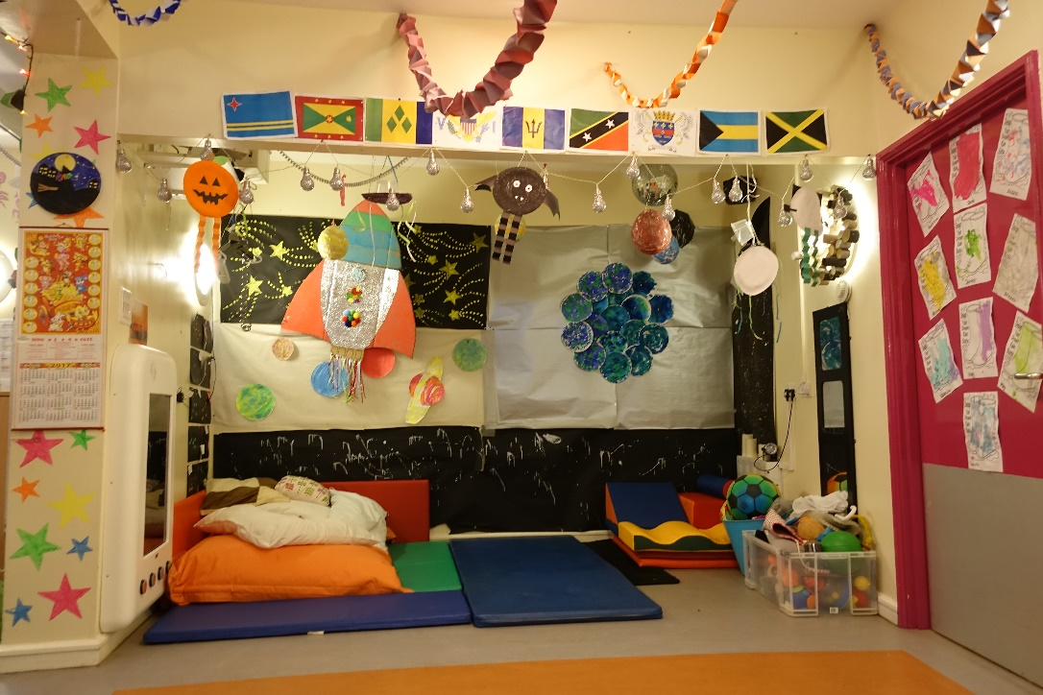
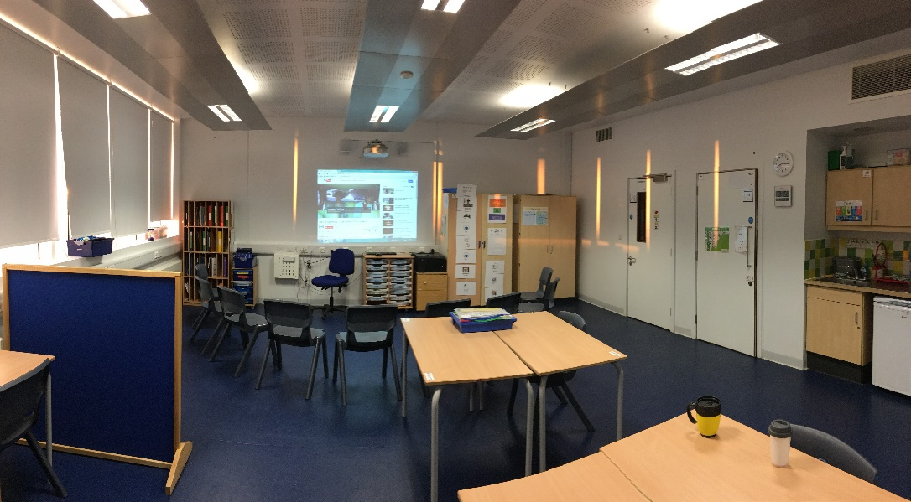
Considerations for Multisensory Environments
Is the layout of the classroom flexible? Does this create clearly defined spaces for different activities? Do learners know what happens where?

Slide 6
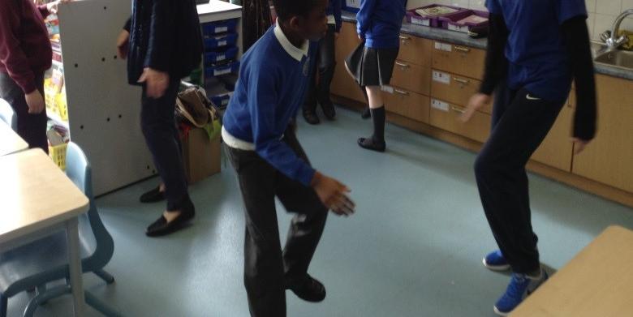
Considerations for Multisensory Environments
Is there space for learners who need to move to be ready for learning?

Slide 7
Considerations for Multisensory Environments
Is the temperature of your classroom easily adjusted?

Slide 8
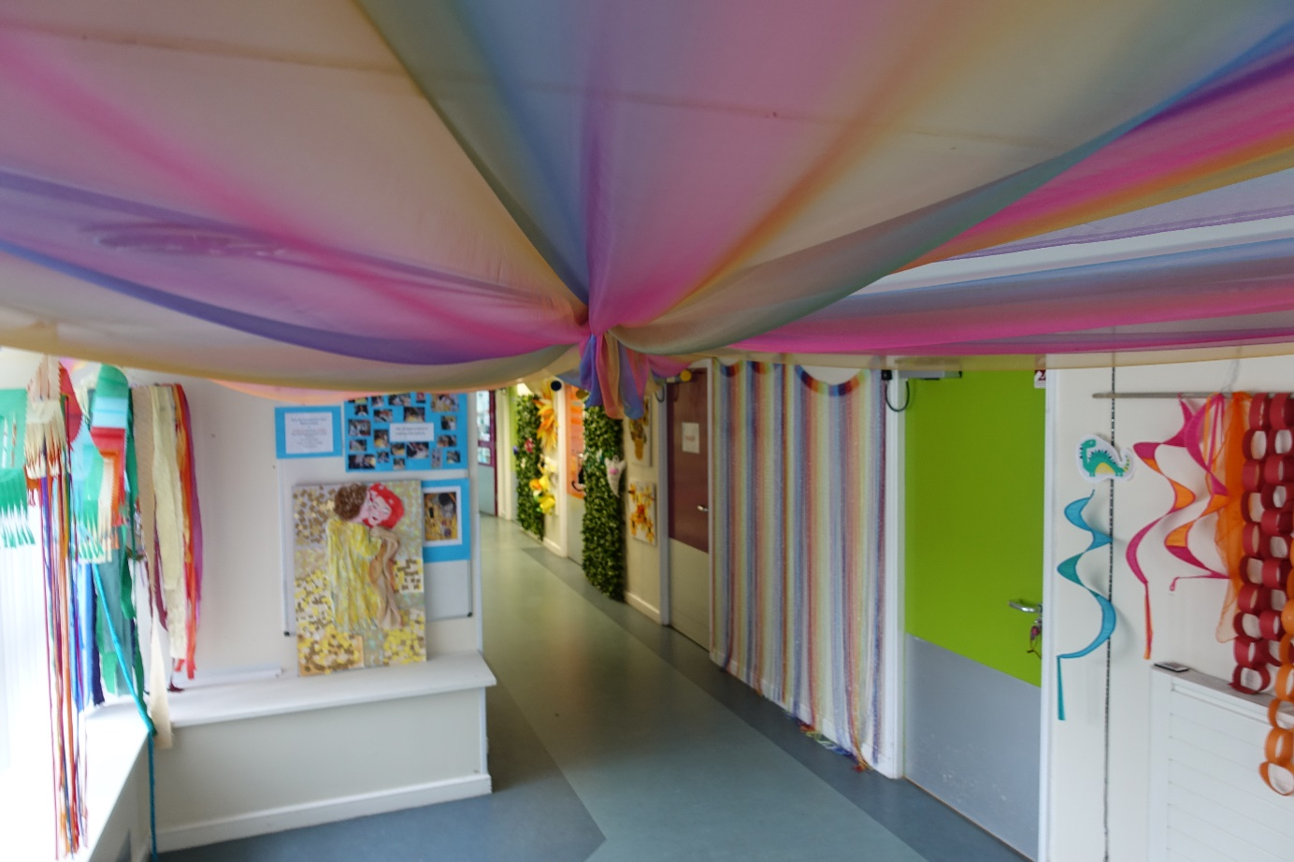
Considerations for Multisensory Environments
Are the colours of the walls ‘low arousal’? Are there contrasting colours to enable learners to identify door frames/windows/seating areas or to locate themselves?

Slide 9
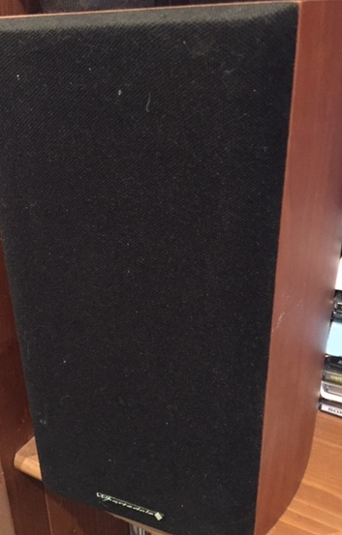
Considerations for Multisensory Environments
Can you manage sound levels to suit learners who might need this increased or decreased?

Slide 10
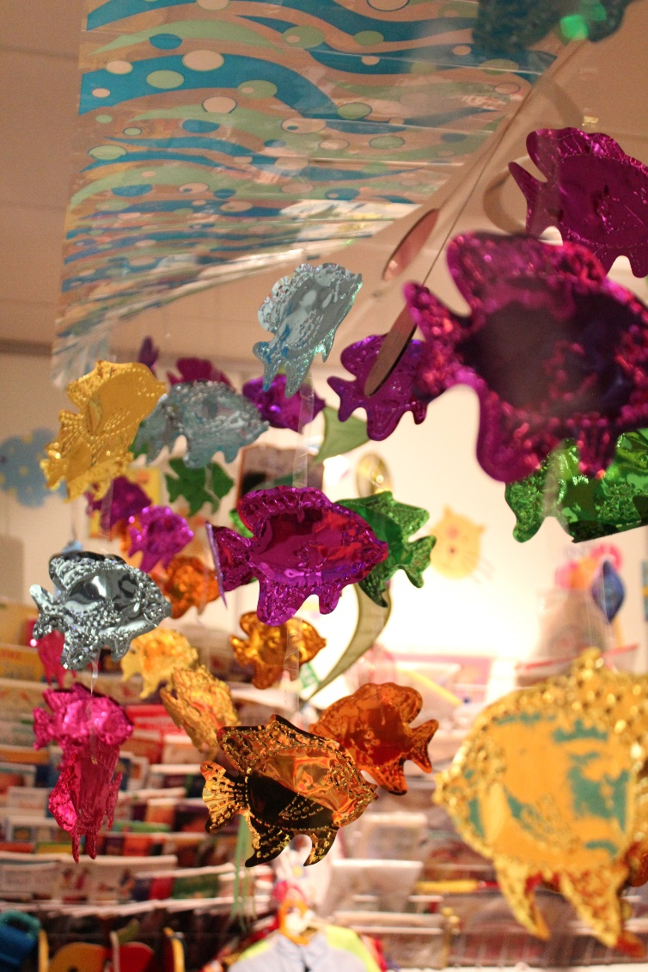
Considerations for Multisensory Environments
Can you create ‘islands of learning’ i.e. a sensory den, a space for messy play or a basket of different textures where learner’s curiosity is engaged?

Slide 11
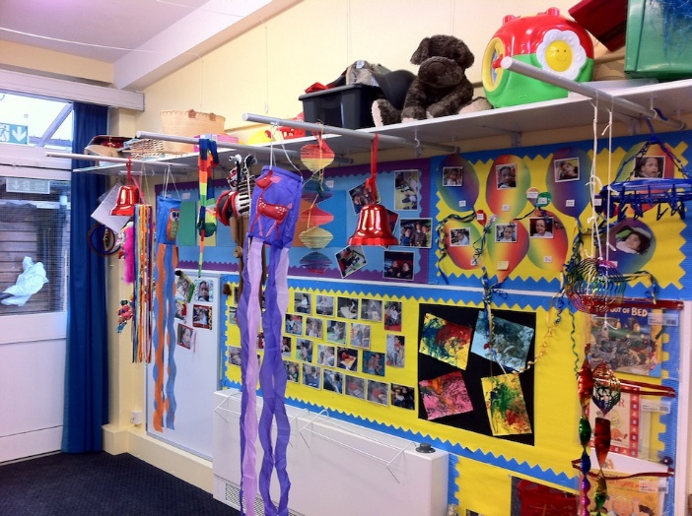
Considerations for Multisensory Environments
Does your classroom offer a diverse variety of different sensory experiences?

